Slide 1

JAWAHAR EDUCATION SOCIETY
A.C. PATIL COLLEGE OF ENGINEEING
DEPARTMENT OF AI&DS
Movie Review Sentiment Analyzer
NAME OF GROUP MEMBERS:-
1. Rohan Ramchandra Chorge(10)
2. Yash Dhondu Gawade(13)
3.Vedant Vikas Kharade(24)

Slide 2
Movie Review Sentiment Analyzer
"good movie" → Positive
"boring plot" → Negative
NLP Mini Project | Semester VII
[Student name(s)] | Guide: [Teacher name]
Example predictions
Notes:
Introduce the project: a system that reads a movie review and says whether it is positive or negative.

Slide 3
Problem and objectives
The problem
Objectives
Thousands of reviews cannot be read by hand, and keyword methods miss context such as "not good".
Clean and prepare the IMDB reviews
1
2
Build a TF-IDF + Logistic Regression baseline
Our approach
3
Fine-tune the DistilBERT transformer
Compare a classic ML model with a fine-tuned transformer, then serve the best one in a web app.
4
Compare both, then deploy with Gradio
Notes:
Explain why sentiment analysis matters and list the four objectives.

Slide 4
Tools and technologies
1
Colab
2
Hugging Face
3
scikit-learn
Free T4 GPU to train the model
IMDB dataset, DistilBERT and Trainer
TF-IDF, Logistic Regression, metrics
4
PyTorch
5
Pandas + Plots
6
Gradio
Deep-learning engine behind DistilBERT
Results table and confusion matrices
Web page to test any review
Notes:
Walk through each tool and what it was used for.

Slide 5
How the system works
TF-IDF + LogReg
baseline
IMDB reviews
5,000 subset
Preprocess
clean, tokenise
Evaluate
accuracy, F1
Gradio app
live demo
DistilBERT
fine-tuned
Both models see the same test reviews, so the comparison is fair.
Notes:
Reviews are cleaned, two models learn from them, we evaluate both on the same test set, and the fine-tuned DistilBERT powers the web app.

Slide 6
Classical vs transformer
TF-IDF + Logistic Regression
DistilBERT (fine-tuned)
Counts word importance, ignores word order
Trains in seconds and is easy to explain
Misses context such as "not good"
Reads every word in its context
Pretrained, then fine-tuned on reviews
Needs a GPU and takes longer to train
Notes:
Explain the trade-off: simple and fast versus context-aware and heavier.

Slide 7
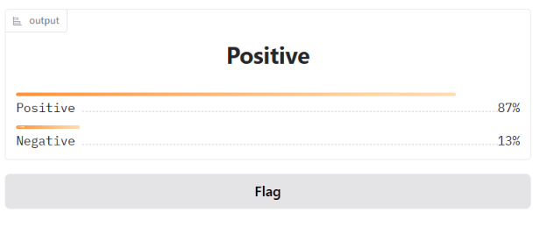
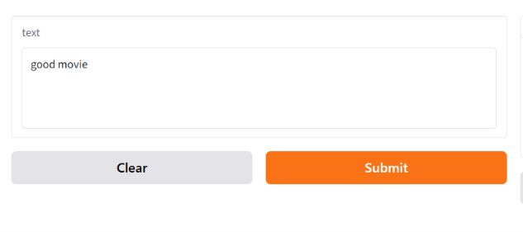
Results and live demo
Model | Accuracy | F1 score
TF-IDF + LogReg | 0.843 | 0.842843
DistilBERT | 0.832 | 0.828571
Gradio demo screenshot
Confusion matrices
Notes:
Show the comparison table, then run the live Gradio demo with one positive and one negative review.

Slide 8
Conclusion and future scope
What we showed
Next steps
Both models label IMDB reviews as positive or negative
DistilBERT reads context; TF-IDF only counts words
The Gradio app returns a label and a confidence score
Train on all 25,000 reviews
Add Hindi, Marathi and Hinglish reviews
Explain predictions with LIME or SHAP
Host the app on Hugging Face Spaces
Thank you | Questions?
Notes:
Summarise, mention future scope, and invite questions.

